Slide 1
File Storage Services

Slide 2






AWS File Storage and Data Transfer Services
Amazon S3
Amazon S3 Glacier
Amazon Elastic Block Store
Amazon Elastic File System
AWS Snowball
AWS
Snowmobile

Slide 3

Reviewing the storage services on AWS
Examining Amazon S3 and its capabilities
Implementing a static website on Amazon S3
Exploring archive capabilities with Glacier and Glacier Deep Archive
Reviewing EC2 storage with EBS and EFS
Examining large-scale data transfer services into AWS
Overview

Slide 4
Amazon S3 Overview

Slide 5

Amazon Simple Storage Service (S3)
Stores files as objects in buckets
Provides different storage classes for different use cases
Stores data across multiple availability zones
Enables URL access for files
Offers configurable rules for data lifecycle Can serve as a static website host

Slide 6
Amazon S3 Non-archival Storage Classes
S3 Standard is the default storage class and is for frequently accessed data
S3 Intelligent-Tiering will move your data to the correct storage class based on usage
S3 Standard-IA is for infrequently accessed data with the standard resilience
S3 One Zone-IA is for infrequently access data that is only stored in one AZ

Slide 7
Automatically moves files
based on access
Moves between frequent and infrequent access
Same performance as
S3-Standard
S3 Intelligent Tiering Storage Class

Slide 8
Objects in a bucket can transition or expire based on your criteria
Transitions can enable objects to move to another storage class based on time
Expiration can delete objects based on age
Policies can also factor in versions of a specific object in the bucket
S3 Lifecycle
Policies

Slide 9
S3 Transfer Acceleration
Feature that can be enabled per bucket that allows for optimized uploading of data using the AWS Edge Locations as a part of Amazon CloudFront.

Slide 10
Hosting a Website on Amazon S3

Slide 11
Demo
Creating a new S3 bucket Uploading objects to an S3 bucket
Accessing object from S3 bucket from URL Configuring a bucket for website hosting

Slide 12
Secure and Protect AWS S3 Buckets

Slide 13
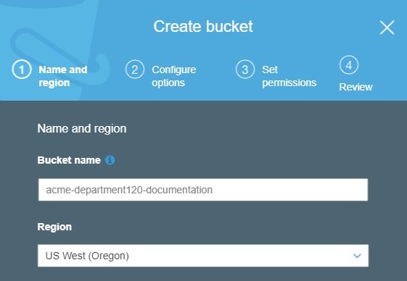
Selecting an Appropriate Name

Slide 14
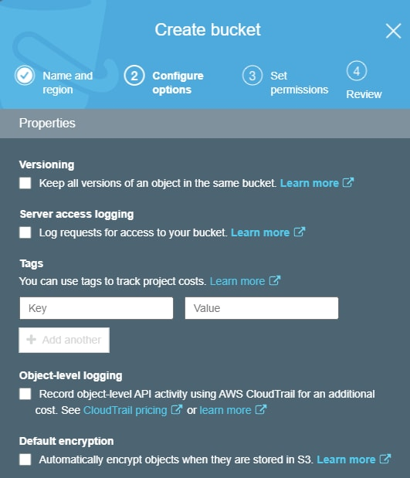
Access and Activity Logging

Slide 15
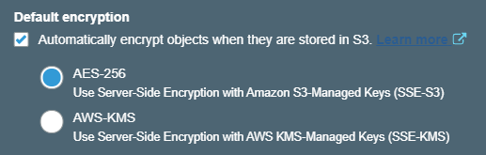
Encryption

Slide 16
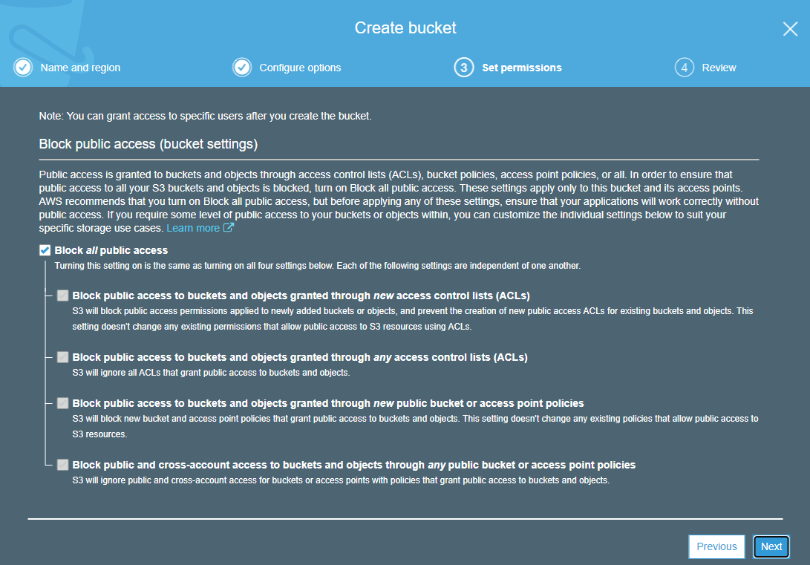
Bucket Permissions

Slide 17
Glacier and Glacier Deep Archive

Slide 18
Amazon S3 Glacier
Designed for archiving of data within S3 as separate storage classes
Offers configurable retrieval times
Can send files directly or through lifecycle rules in S3
Provides two different storage classes
S3 Glacier
S3 Glacier Deep Archive

Slide 19
Amazon S3 Glacier Storage Classes
S3 Glacier
Designed for archival data 90 day minimum storage duration
change
Can be retrieved in either minutes or
hours
You pay a retrieval fee per GB retrieved Over 5 times less expensive than S3
Standard storage class
S3 Glacier Deep Archive
Designed for archival data
180 day minimum storage duration change
Can be retrieved in hours
You pay a retrieval fee per GB retrieved
Over 23 times less expensive than S3 Standard storage class

Slide 20
“The AWS Management console can be used to quickly set up Amazon S3 Glacier. Data can then be uploaded and retrieved programmatically.”
Amazon Web Services

Slide 21
Elastic Block Store

Slide 22








Amazon EC2 File Storage Services
Amazon EBS
Persistent block storage for use with Amazon EC2
Amazon EFS
Elastic file system for use with Linux-based workloads

Slide 23
Amazon Elastic Block Store (EBS)
Block storage designed to be connected to a single EC2 instance that can scale to support petabytes of data and supports multiple volume types based on need.

Slide 24




Amazon Elastic Block Store (EBS)
Enables redundancy within an AZ
Allows users to take snapshots of its data Offers encryption of its volumes
Provides multiple volume types
General purpose SSD
Provisioned IOPS SSD
Throughput optimized HDD
Cold HDD

Slide 25
Amazon EBS Volume Types
General Purpose SSD is a cost effective type designed for general workloads
Provisioned IOPS SSD high performance volume for low latency applications
Throughput Optimized HDD is designed for frequently accessed data
Cold HDD is designed for less frequently accessed workloads

Slide 26
Elastic File System

Slide 27




Amazon Elastic File System (EFS)
Fully managed NFS file system
Designed for Linux workloads
Supports up to petabyte scale Stores data across multiple AZ’s
Provides two different storage classes
Standard
Infrequent access
Provides configurable lifecycle data rules

Slide 28





Elastic File System Example
us-east-1
VPC
Elastic File System
availability zone a availability zone b

Slide 29

Amazon FSx for Windows File Server
Fully managed native Windows file system
Includes native Windows features including
SMB support
Active Directory integration
Windows NTFS
Utilizes SSD drives for low latency

Slide 30
Data Transfer with AWS Snowball

Slide 31
AWS Large Scale Data Transfer Services
AWS Snowball
Service to physically migrate petabyte scale data to AWS
AWS Snowmobile
Service to physically migrate exabyte scale data onto AWS

Slide 32
Large-scale Data Transfer into AWS
AWS Snowball
Designed for large-scale data transfer Supports petabyte scale transfer Physical device is delivered by AWS
You connect the Snowball to your network and upload your data
Device is returned by local carrier AWS receives device and loads your
data into S3
AWS Snowmobile
Designed for large-scale data transfer Supports exabyte scale transfer
Ruggedized shipping container is delivered to your location
AWS sets up a connection to your network
You load your data on the Snowmobile
AWS will load data into S3 when the container is received at an AWS location

Slide 33
Scenario Based Review

Slide 34

Scenario 1
Elaine launched a site that offers daily tutorials for developers
She uses S3 to store the assets needed per tutorial
These assets are very popular within the week the tutorial is launched
After this initial week, these assets are rarely accessed
How could Elaine reduce her S3 costs while maintaining durability?

Slide 35

Scenario 2
Esteban works for a social networking company and they are moving to AWS
They have 2 PB of user-generated content that they need to migrate
Esteban is trying to determine if there is a faster than uploading over the internet
Would there be another approach you would recommend for Esteban’s company?

Slide 36

Scenario 3
Emily works for a company that produces a messaging app
She is looking for a shared file system between 8 different Linux EC2 instances
The file system would need to support roughly 1 PB of data
What approach would you recommend for Emily?

Slide 37
Summary

Slide 38
Reviewed the storage services on AWS
Examined Amazon S3 and its capabilities
Implemented a static website on Amazon S3
Explored archive capabilities with Glacier and Glacier Deep Archive
Reviewed EC2 storage with EBS and EFS
Examined large-scale data transfer services into AWS
Overview

Slide 39
Scenario 1
Elaine launched a site that offers daily tutorials for developers
She uses S3 to store the assets needed per tutorial
These assets are very popular within the week the tutorial is launched
After this initial week, these assets are rarely accessed
How could Elaine reduce her S3 costs while maintaining durability?
Solution: S3 lifecycle rules with S3-Standard IA storage class

Slide 40
Scenario 2
Esteban works for a social networking company and they are moving to AWS
They have 2 PB of user-generated content that they need to migrate
Esteban is trying to determine if there is a faster than uploading over the internet
Would there be another approach you would recommend for Esteban’s company?
Solution: AWS Snowball

Slide 41
Scenario 3
Emily works for a company that produces a messaging app
She is looking for a shared file system between 8 different Linux EC2 instances
The file system would need to support roughly 1 PB of data
What approach would you recommend for Emily?
Solution: Amazon Elastic File System

